Slide 1
WFM v9_1 Derivations
Jeremy Petak
April 12, 2016

Slide 2
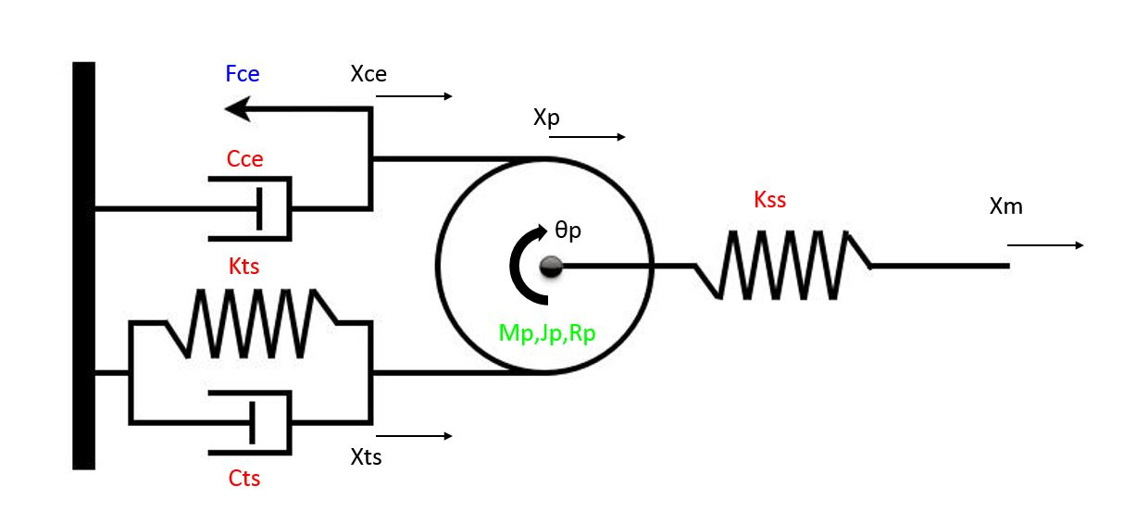
WFMv9

Slide 3
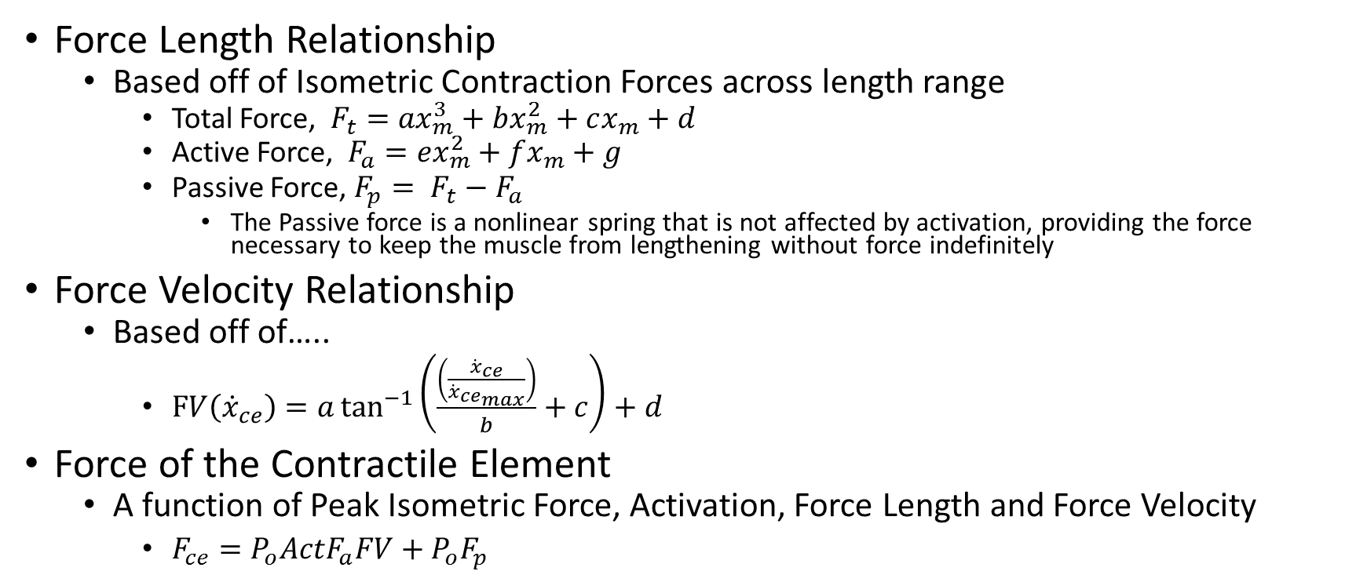
Force of the Contractile Element
Force Length Relationship
Based off of Isometric Contraction Forces across length range
Total Force, ${F_{t}=ax}_{m}^{3}+bx_{m}^{2}+cx_{m}+d$
Active Force, ${F_{a}=ex}_{m}^{2}+fx_{m}+g$
Passive Force, $F_{p}= F_{t}−F_{a}$
The Passive force is a nonlinear spring that is not affected by activation, providing the force necessary to keep the muscle from lengthening without force indefinitely
Force Velocity Relationship
Based off of…..
$FV\left({\dot{x}}_{ce}\right)=a\tan^{−1}\left(\frac{\left(\frac{{\dot{x}}_{ce}}{{\dot{x}}_{{ce}_{max}}}\right)}{b}+c\right)+d$
Force of the Contractile Element
A function of Peak Isometric Force, Activation, Force Length and Force Velocity
$F_{ce}=P_{o}ActF_{a}FV+P_{o}F_{p}$

Slide 4
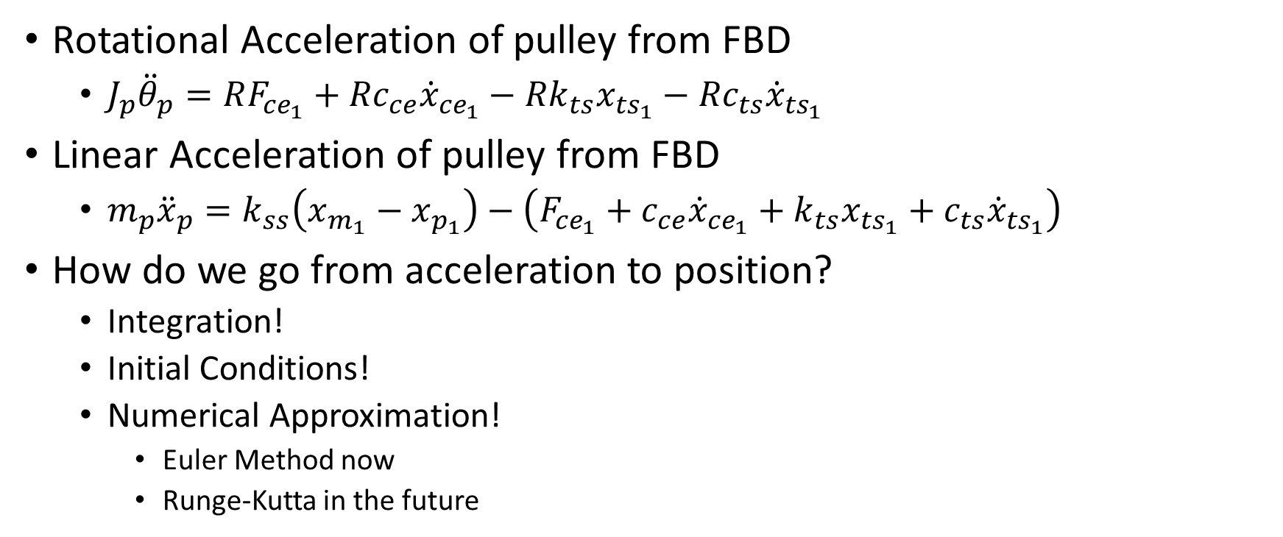
Derivations
Rotational Acceleration of pulley from FBD
$J_{p}{\ddot{θ}}_{p}=RF_{{ce}_{1}}+{Rc}_{ce}{\dot{x}}_{{ce}_{1}}−{Rk}_{ts}x_{{ts}_{1}}−{Rc}_{ts}{\dot{x}}_{{ts}_{1}}$
Linear Acceleration of pulley from FBD
$m_{p}{\ddot{x}}_{p}=k_{ss}\left(x_{m_{1}}−x_{p_{1}}\right)−\left(F_{{ce}_{1}}+c_{ce}{\dot{x}}_{{ce}_{1}}+k_{ts}x_{{ts}_{1}}+c_{ts}{\dot{x}}_{{ts}_{1}}\right)$
How do we go from acceleration to position?
Integration!
Initial Conditions!
Numerical Approximation!
Euler Method now
Runge-Kutta in the future

Slide 5
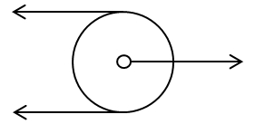


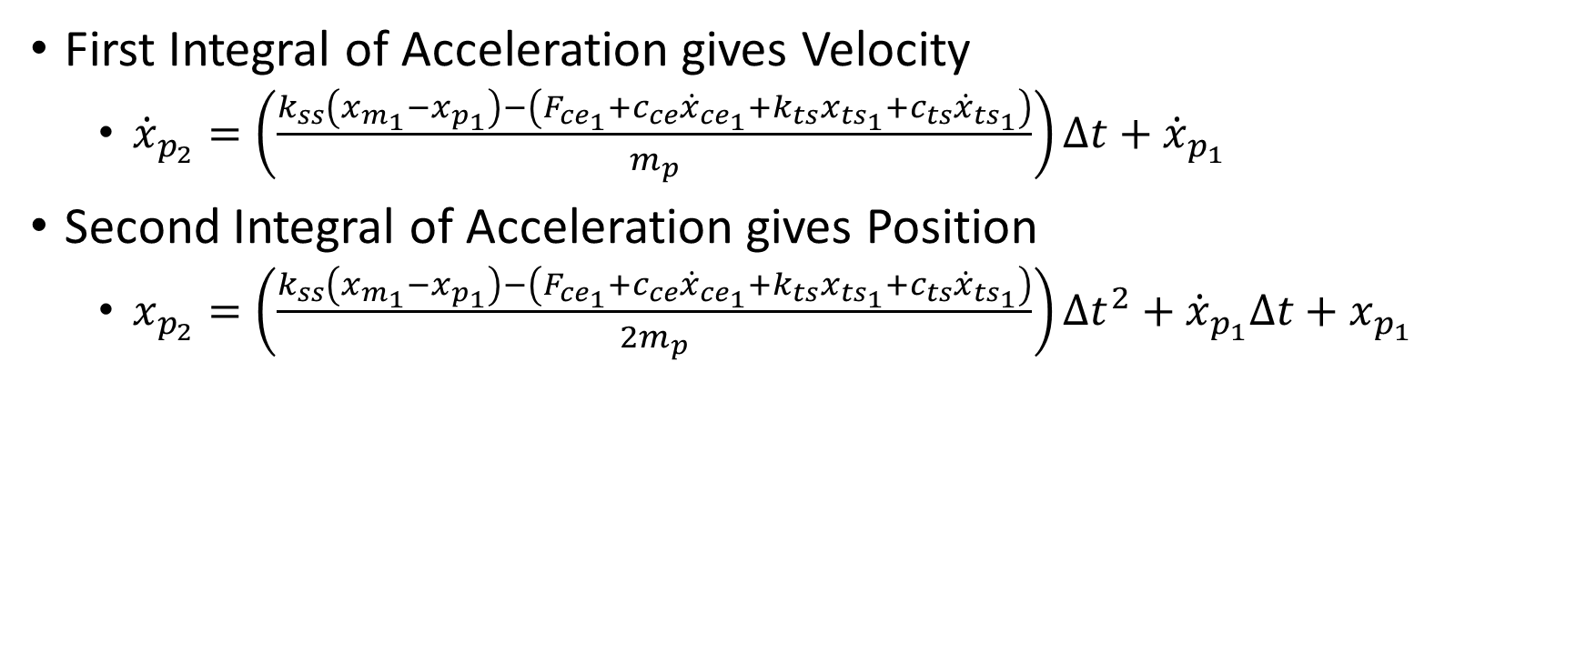



Translation Velocity and Position of Pulley
First Integral of Acceleration gives Velocity
${\dot{x}}_{p_{2}}=\left(\frac{k_{ss}\left(x_{m_{1}}−x_{p_{1}}\right)−\left(F_{{ce}_{1}}+c_{ce}{\dot{x}}_{{ce}_{1}}+k_{ts}x_{{ts}_{1}}+c_{ts}{\dot{x}}_{{ts}_{1}}\right)}{m_{p}}\right)∆t+{\dot{x}}_{p_{1}}$
Second Integral of Acceleration gives Position
$x_{p_{2}}=\left(\frac{k_{ss}\left(x_{m_{1}}−x_{p_{1}}\right)−\left(F_{{ce}_{1}}+c_{ce}{\dot{x}}_{{ce}_{1}}+k_{ts}x_{{ts}_{1}}+c_{ts}{\dot{x}}_{{ts}_{1}}\right)}{2m_{p}}\right)∆t^{2}+{\dot{x}}_{p_{1}}∆t+x_{p_{1}}$
$$x_{p},{\dot{x}}_{p}$$
$$F_{ce}+c_{ce}{\dot{x}}_{ce}$$
$$k_{ss}\left(x_{m}−x_{p}\right)$$
$$k_{ts}x_{ts}+c_{ts}{\dot{x}}_{ts}$$
$$m_{p}$$

Slide 6
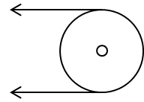


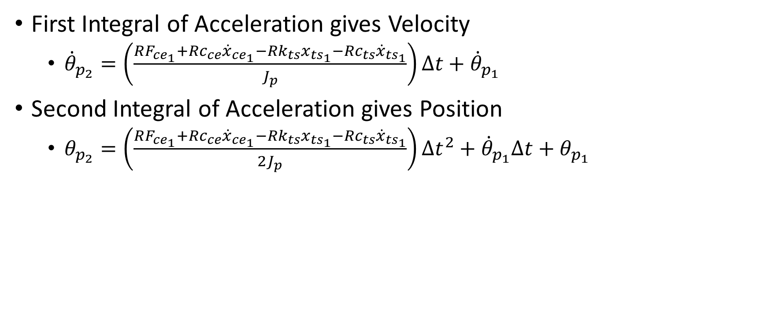



Rotational Velocity and Position of Pulley
First Integral of Acceleration gives Velocity
${\dot{θ}}_{p_{2}}=\left(\frac{RF_{{ce}_{1}}+{Rc}_{ce}{\dot{x}}_{{ce}_{1}}−{Rk}_{ts}x_{{ts}_{1}}−{Rc}_{ts}{\dot{x}}_{{ts}_{1}}}{J_{p}}\right)∆t+{\dot{θ}}_{p_{1}}$
Second Integral of Acceleration gives Position
$θ_{p_{2}}=\left(\frac{RF_{{ce}_{1}}+{Rc}_{ce}{\dot{x}}_{{ce}_{1}}−{Rk}_{ts}x_{{ts}_{1}}−{Rc}_{ts}{\dot{x}}_{{ts}_{1}}}{{2J}_{p}}\right)∆t^{2}+{\dot{θ}}_{p_{1}}∆t+θ_{p_{1}}$
$${RF}_{ce}+{Rc}_{ce}{\dot{x}}_{ce}$$
$$R$$
$$θ_{p},{\dot{θ}}_{p}$$
$${Rk}_{ts}x_{ts}+{Rc}_{ts}{\dot{x}}_{ts}$$
$$J_{p}$$

Slide 7
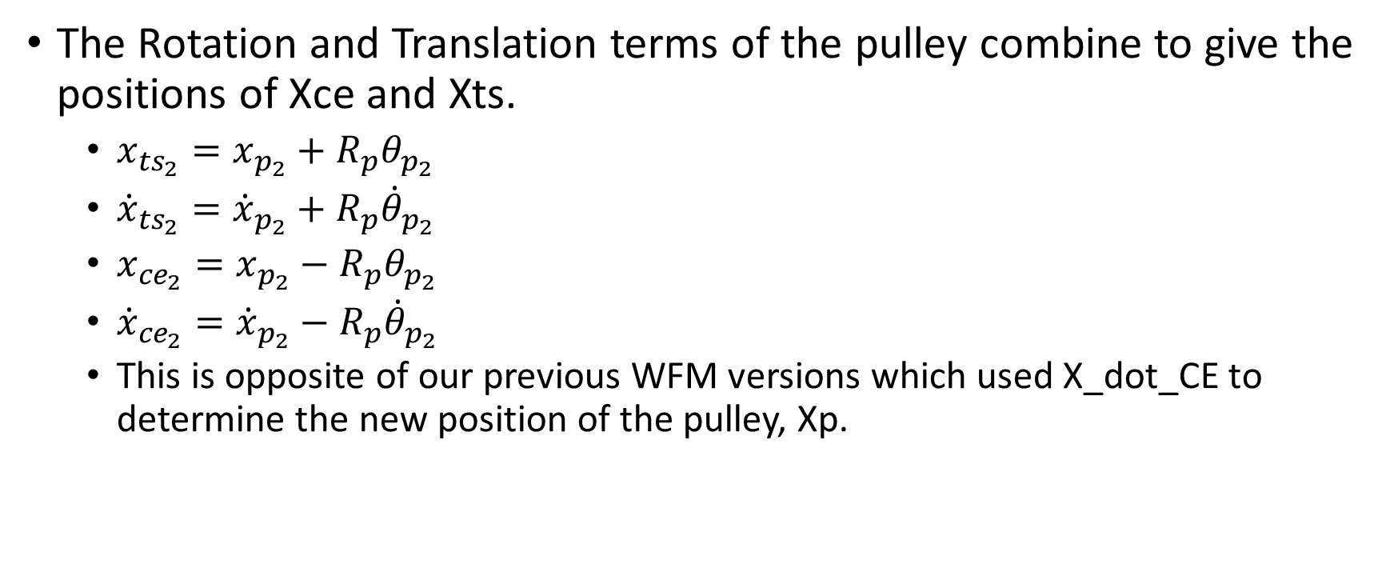
Addition of Rotation and Translation
The Rotation and Translation terms of the pulley combine to give the positions of Xce and Xts.
$x_{{ts}_{2}}=x_{p_{2}}+R_{p}θ_{p_{2}}$
${\dot{x}}_{{ts}_{2}}={\dot{x}}_{p_{2}}+R_{p}{\dot{θ}}_{p_{2}}$
$x_{{ce}_{2}}=x_{p_{2}}−R_{p}θ_{p_{2}}$
${\dot{x}}_{{ce}_{2}}={\dot{x}}_{p_{2}}−R_{p}{\dot{θ}}_{p_{2}}$
This is opposite of our previous WFM versions which used X_dot_CE to determine the new position of the pulley, Xp.

Slide 8
Model Intricacies
Direction matters!
The forces applied to the system have a positive and negative direction. So, if you are applying new elements, or are looking at the terms in the code verses the derivation, remember that lengthening is positive and it should make more sense.
Free undamped vibrations
Explains addition of Titin Spring Damper and continuing to use Contractile Element Damper
The relationship between the damping rate and the mass and moment of inertia of the pulley is important to defining the natural frequency of the system and the system’s performance
Modular setup
Due to the double integration method, we can add/remove/modify model elements at will without significantly changing the derivation’s approach
Example: The CE damper has a lengthening and shortening damping rate that switches using an ‘if’ statement
Contractile Element Force equation
The Force of the CE can be defined by any equation, and the model used here has the Arctan() equation defining the Force Velocity relationship and is dependent on the velocity of the contractile element and not muscle velocity
Clutch Model
Currently, the model uses the simple switch statement between allowing the pulley to rotate and stopping it based on the force balance between the CE and TS sides and an activation level greater than zero. This model style can easily add a model for a force on the pulley’s axle to account for any type of clutching or ratcheting mechanism that we can think of.

Slide 9
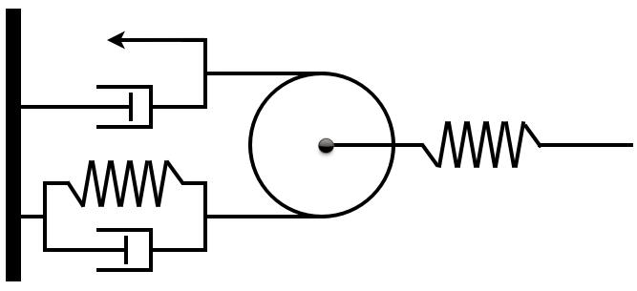
Raw WFMv9 diagram for making into .jpg’s
Fce
Xce
Xp
Cce
Kss
Xm
θp
Kts
Mp,Jp,Rp
Xts
Cts

Slide 10










$$x_{p},{\dot{x}}_{p}$$
$$F_{ce}+c_{ce}{\dot{x}}_{ce}$$
$$k_{ss}\left(x_{m}−x_{p}\right)$$
$$k_{ts}x_{ts}+c_{ts}{\dot{x}}_{ts}$$
$$m_{p}$$
$${RF}_{ce}+{Rc}_{ce}{\dot{x}}_{ce}$$
$$R$$
$$θ_{p},{\dot{θ}}_{p}$$
$${Rk}_{ts}x_{ts}+{Rc}_{ts}{\dot{x}}_{ts}$$
$$J_{p}$$

